Slide 1

The Equity Office
April Castañeda
Assistant Vice President for Equity, Equity Investigations
Title IX Coordinator

Slide 2
key points
equity
Philosophy
approach
expectations
Roles
work
Data
Resources

Slide 3
How do you Define Equity?

Slide 4

equity
Equity concerns itself with fair and impartial treatment and processes that support a community of inclusion, learning, professionalism, safety, care, and respect.

Slide 5

philosophy
The Equity Office believes in fostering a fair and equitable environment through a clear, communicative, and transparent problem solving and investigation processes.

Slide 6

approach
The Equity Office strives to:
be a credible, transparent, and trusted resource
promote an inclusive learning and working environment free of discrimination, harassment, and violence
be focused on solutions that support the community and encourage a respectful Caltech culture

Slide 7

work
The Equity Office investigates, addresses, and educates the entire Caltech community, including staff, faculty, and students on Title VII and Title IX issues such as:
unlawful harassment
sexual misconduct
discrimination

Slide 8
What are your expectations of an Equity Office?

Slide 9

expectations
You can expect the following from the office:
Equitable and fair treatment
Strong commitment to a safe campus and working environment
Clear communication
Humane compliance
Solution-based approach to our work
Intent listening
Timely and transparent processes
Collegial behavior
Credible resources

Slide 10
Roles

Slide 11

assistant vice president for equity
Responsible for development and review of Institute policies related to discrimination and harassment
Charged with receiving, responding to and addressing issues, reports and complaints of discrimination, harassment and sexual violence
Chief administrator overseeing the Institute’s compliance with Titles VI, VII, and IX and has primary responsibility for addressing reports and grievances related to protected classes
Ensure compliance with those policies as well as with federal, state and local discrimination and educations laws

Slide 12

lead investigator for equity & title ix
Supports the Institute’s commitment to an open, diverse and inclusive learning, living and working environment
Responsible for complex investigations resulting from claims of discrimination, harassment or retaliation made by students, faculty or staff
Conducts prompt, thorough, impartial and equitable investigations of prohibited conduct
Provides comprehensive training and education on Title VII and Title IX policies and procedures to faculty, staff and students

Slide 13
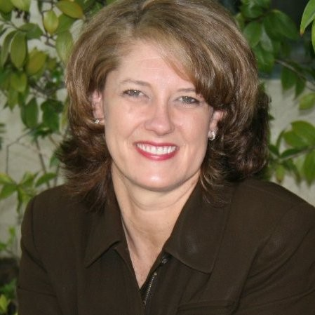
administrator for the equity office
Responsible for logistical and administrative operations of the Equity Office
Manages the data, systems, and reporting information
Keeper of office records, processes, and data
Monitors the investigation process and follows up on the steps of the process
Maintains templates, checklists, guidelines and training material for the office
Collaborates with other campus reporting organizations (i.e. security, human resources, institutional research)

Slide 14
deputy title ix coordinators
A trusted and credible resource for staff, faculty, and students around issues related to sexual harassment, sexual misconduct, and sex discrimination
Receive reports of sex discrimination, sexual misconduct, and sexual harassment
Provide information to staff, faculty, and students regarding reporting including complaint and investigation procedures
Answer questions related to the Institute’s complaint and investigation processes
Advise on available support services, confidential resources, bystander techniques, and informal resolution options
Partners with lead investigator on investigations regarding complaints of sex discrimination, sexual misconduct, or sexual harassment

Slide 15
Are you a responsible employee?
What is a responsible employee?

Slide 16

Responsible Employee
A responsible employee is someone:
Who has the authority to take action to redress sexual harassment/violence
Who has been given the duty of reporting incidents of sexual harassment/violence or any other sexual misconduct to the Title IX Coordinator, deputies, or other appropriate school designee
That a student/employee could reasonably believe has either the authority or the duty listed above
Who reports allegations of sexual harassment/violence that takes place on or off campus to the Title IX Coordinator or deputies to maximize the institution's ability to investigate and potentially address and eliminate sexual harassment/violence

Slide 17

Responsible Employees at Caltech
Managers are Responsible Employees under Title IX
Caltech is required to take corrective action if a Responsible Employee is aware of harassment
When you learn about an incident, you must contact the Title IX coordinator or a Deputy Title IX Coordinator

Slide 18

Responsible Employee Role
To foster a sense of inclusion, safety, resilience, respect and engagement in support of a learning community
Title IX: Report Title IX incidences to the Title IX Coordinator or a Deputy Coordinator
Clery: Report Incidences of crime to Security

Slide 19
What to Do

Slide 20
What would you say if someone told you they were being discriminated against?

Slide 21

Step I - Listen
Be supportive
Validate feelings
Thank them for coming to you and trusting you

Slide 22

Step II – Explain Your Role
You are here to make sure they are safe
Offer resources, including confidential resources and the Equity Office
Inform the reporter that you will need to contact the Equity Office

Slide 23

Step III – Contact Equity Office
Caltech has an obligation to look into an incident when it is reported to a Responsible Employee
We want to make sure we are responsive
Title IX Coordinator can be reached at 3132 or titleixcoordinator@caltech.edu

Slide 24

Remember
Let the reporter know you will have to contact the Title IX Coordinator
Ask fact-based questions that do not imply judgement
Allow the reporter to articulate how they want things handled

Slide 25
Data

Slide 26
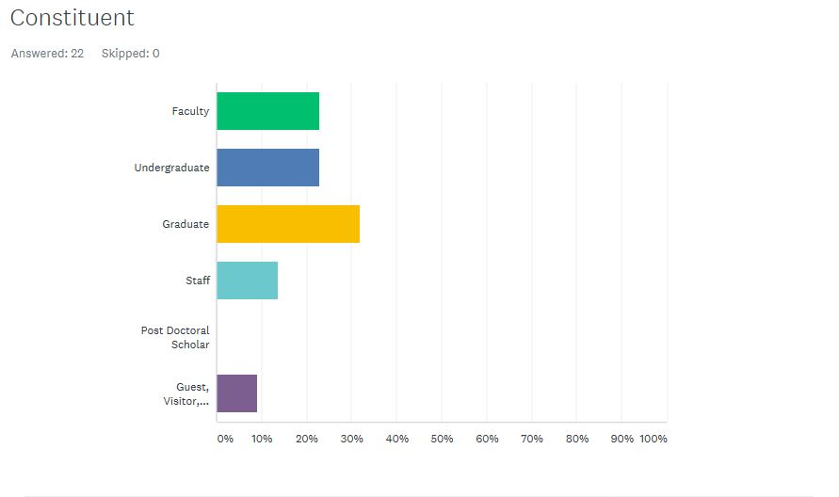
Constituent Contact since August 1

Slide 27
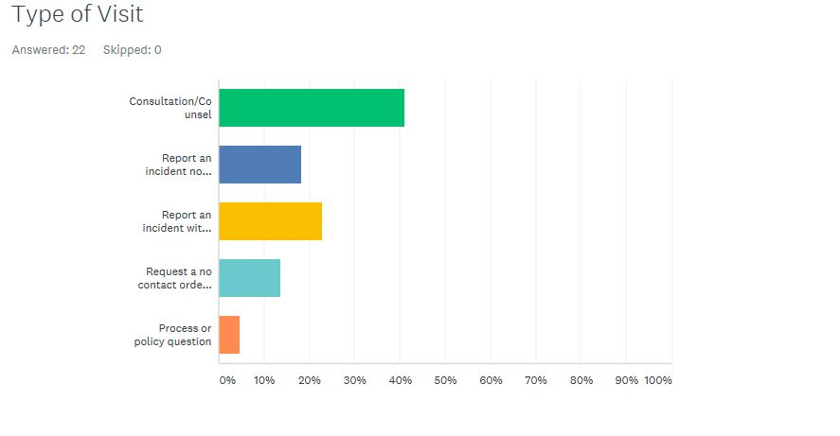
Type of Visit

Slide 28
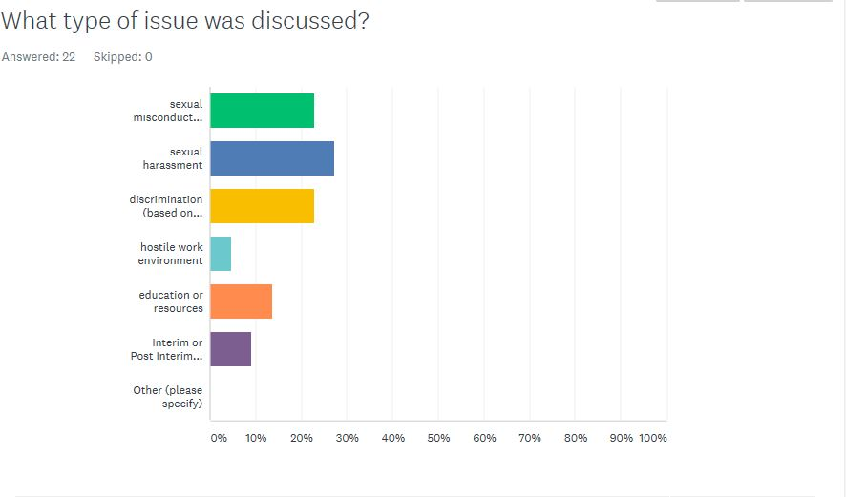
Type of Issues Discussed

Slide 29
Resources

Slide 30
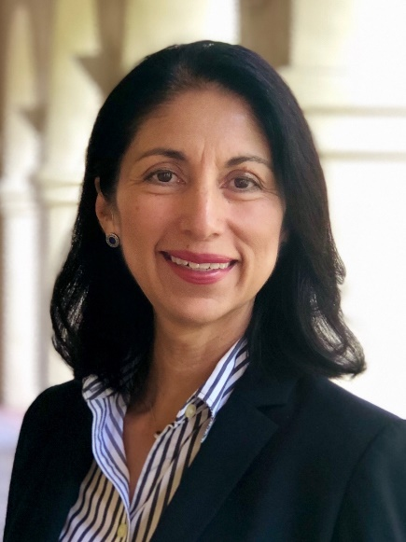

Reporting Resources
Deputy Title IX Coordinator for Staff
Ofelia Velazquez-Perez
Deputy Title IX Coordinator for Faculty
Melany Hunt
Deputy Title IX Coordinator for Students
TBD
Associate Director of Employee and Organizational Development
x3819 ofelia.velazquez-perez@caltech.edu
x4231 hunt@caltech.edu
Dotty and Dick Hayman Professor of Mechanical Engineering

Slide 31

Confidential Resources
Counseling Center
Center for Diversity
Staff & Faculty Consultation Center

Slide 32
The Equity Office

